Slide 1
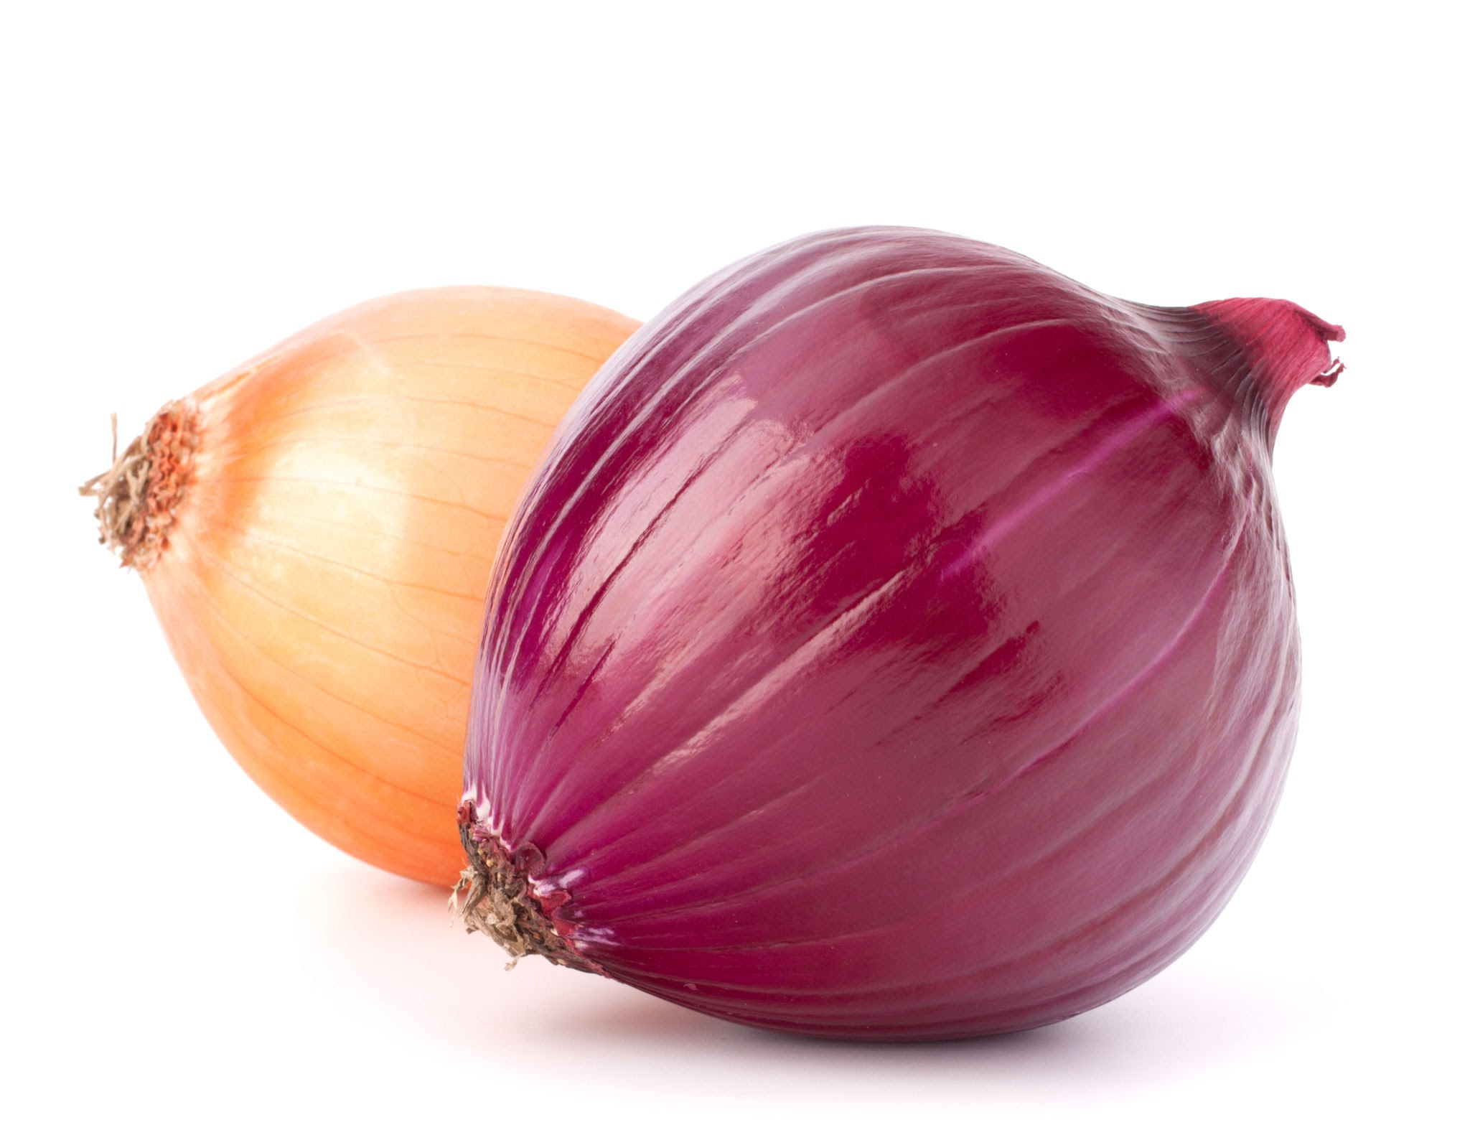
Onion Market Data Insights
By Jared Bean

Slide 2
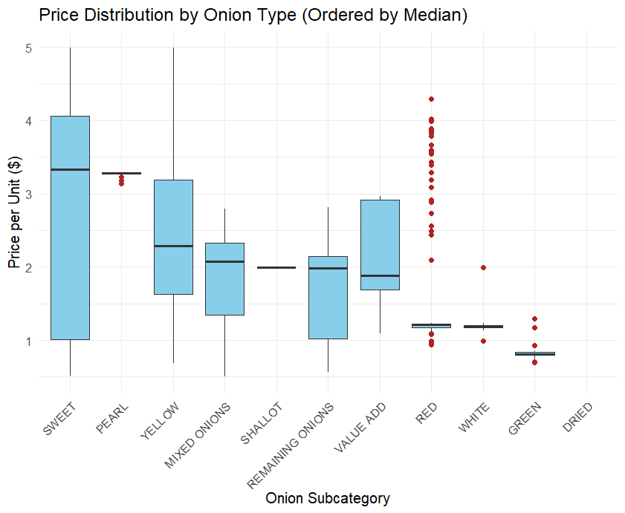
Onion Variety Price Comparison
Highest median price: Sweet Onion
Lowest median price: Green Onion
Red Onion prices frequently vary from the $1.21 median
Onion Type | SWEET | PEARL | YELLOW | MIXED ONIONS | SHALLOT | REMAINING ONIONS | VALUE ADD | RED | WHITE | GREEN | DRIED
Median Price ($) | 3.33 | 3.28 | 2.29 | 2.07 | 1.99 | 1.98 | 1.88 | 1.21 | 1.18 | 0.80 | —
Notes:
Make sure to mention that these calculations are for the most recent 52 weeks

Slide 3
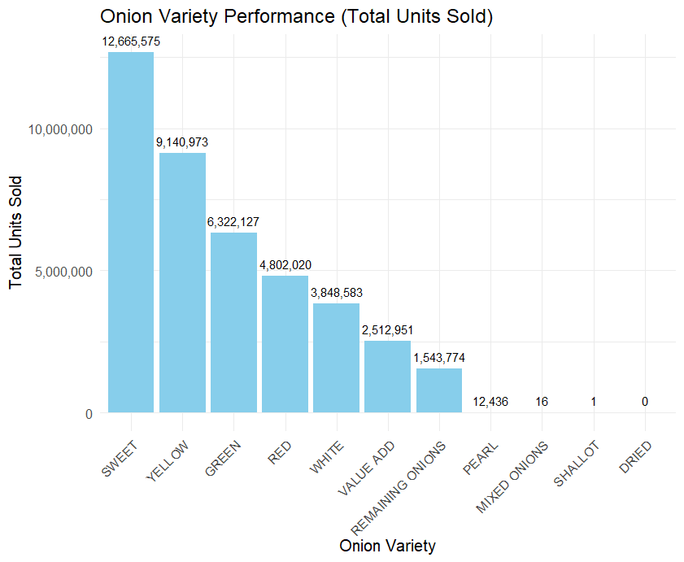
How do different onion varieties compare in performance?
Sweet Onions have the highest total units sold
Sweet Onions are also the most expensive
This could indicate that there is a better consumer experience to justify added cost
Onion Type | SWEET | PEARL | YELLOW | MIXED ONIONS | SHALLOT | REMAINING ONIONS | VALUE ADD | RED | WHITE | GREEN | DRIED
Median Price ($) | 3.33 | 3.28 | 2.29 | 2.07 | 1.99 | 1.98 | 1.88 | 1.21 | 1.18 | 0.80 | —

Slide 4
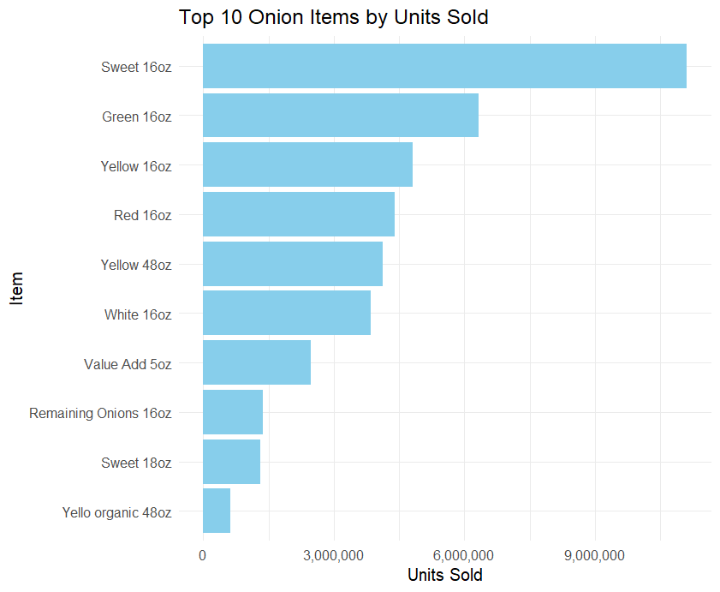
What are the top-performing items (packages)?
Base size represents the typical packaging quantity in which the product is sold
Consumers most frequently purchase onions in 16 oz packages

Slide 5
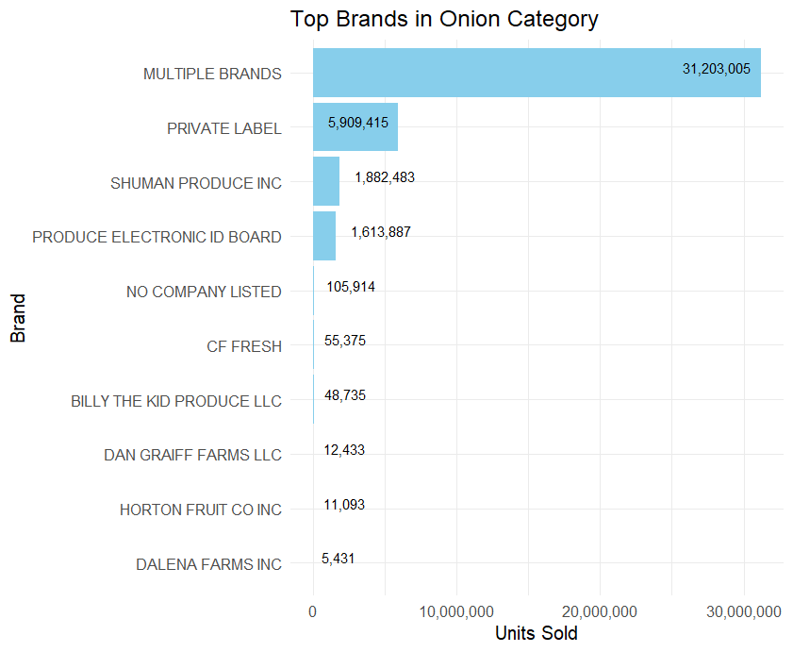
What is the leading onion brand?
Multiple Brands might be referring to a variety of smaller brands not in the system
Private Label is the second-largest seller proving strong consumer preference for store brands
Notes:
What is multiple brands and private label?

Slide 6
How do organic and conventional onions compare?
Organic vs. conventional | Total Units | Total Sales | Avg Price per unit | Avg Revenue | Total Stores
Non-Organic | 114,419,941 | 150,441,985 | $1.31 | $197,079,000 | 5,282,105
Organic | 1,874,944 | 6,020,549 | $3.21 | $19,325,962 | 801,116
Non-Organic generates $177,726,038 more on average
Organic still generates an impressive $19 mil in average revenue

Slide 7
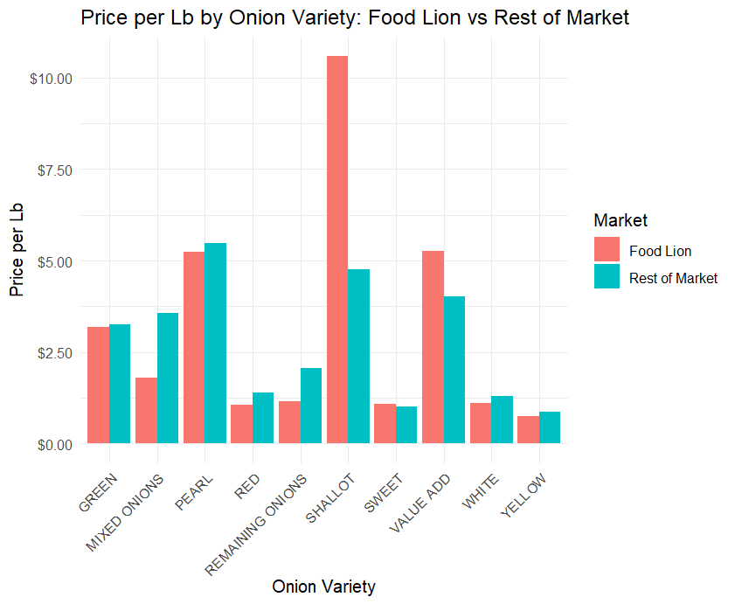
How do onion varieties differ in pricing?
Why is a Shallot Onion so much more expensive with Lion?
Other Lion prices are often lower or comparable with Market prices
This was done with a weighted average
Notes:
Removed Dried Onions because Lion doesn’t sell it, Price dist. Has shallot at 1.99 very spesific

Slide 8
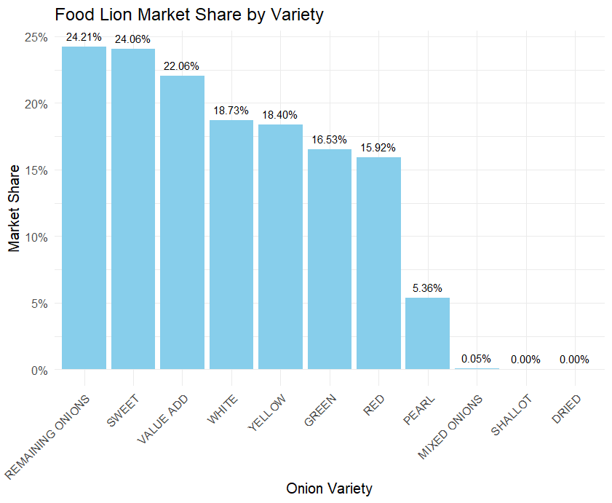
What is Food Lion’s market share by variety?
Food Lion has practically no share in Mixed Onions, but they are priced much lower than the market
Price doesn’t seem like the main factor in market share
Remaining Onions are priced lower than the market, but Sweet Onions are priced higher
Notes:
Sweet Onions still own 24% while being priced higher

Slide 9
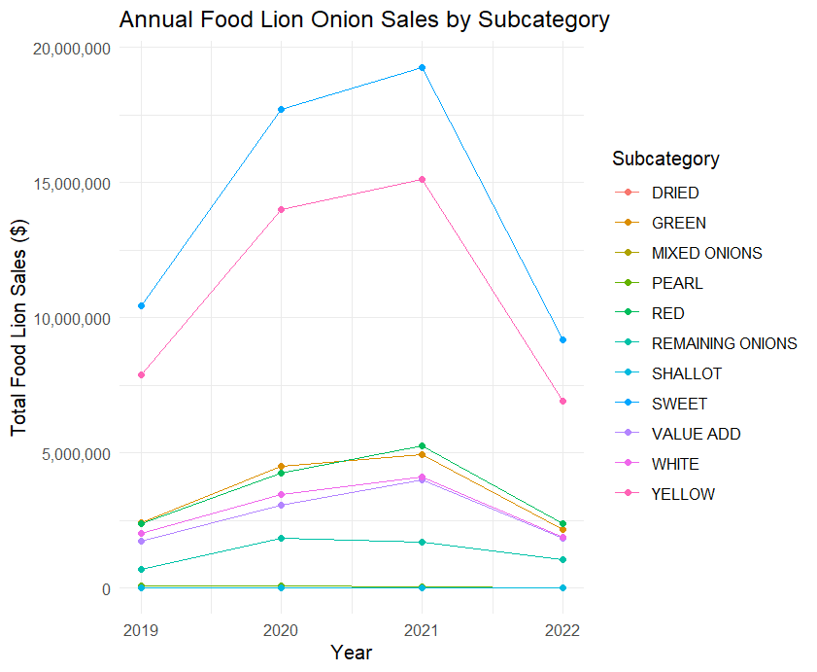
What are the year-over-year % changes for onion varieties?
Sweet Onions and Yellow Onions experienced the most volatility
Note: Shallot Onions get started late and Dried Onions aren’t applicable to Lion
The Packer. (2022). COVID-19’s effects on onion market expected to lighten over summer. The Packer: Markets—Shipping.
Notes:
Covid caused the market to act this way

Slide 10
Year-over-year % changes in onion sales cont.
Onion Type | 2020 | 2021 | 2022
Geen | 86% | 9% | -55%
Mixed | NA | NA | 62%
Pearl | -3.2% | -49% | -57%
Red | 80% | 23% | -54%
Remaining | 163% | -8% | -37%
Sweet | 69% | 8% | -52%
Value Add | 75% | 30% | -54%
White | 71% | 19% | -54%
Yellow | 78% | 8% | -54%
Shallot and Dried were removed because they were not available during these years

Slide 11
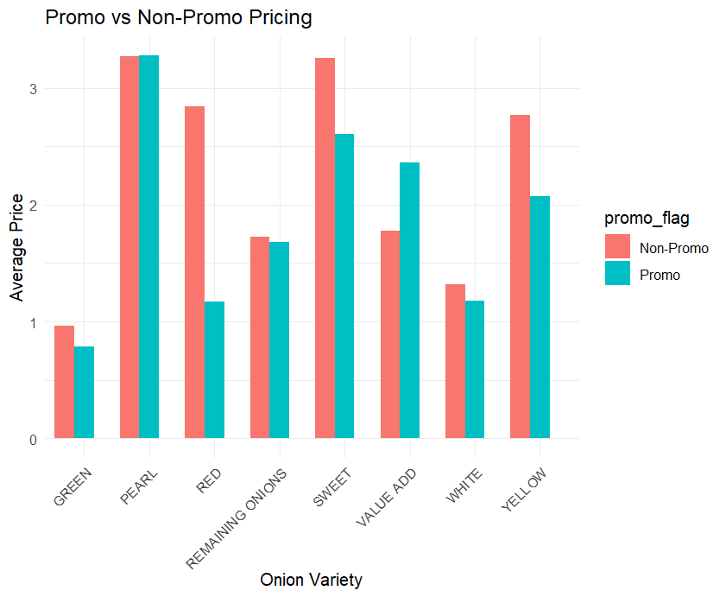
How does promotional pricing compare to non-promotional pricing for each variety?
Value Added Onions are more expensive with promotions
Red Onions experience a significant reduction in price with promotions
Notes:
Dried, Shallot, and Mixed Onions were removed because they don’t have promos to compare with

Slide 12
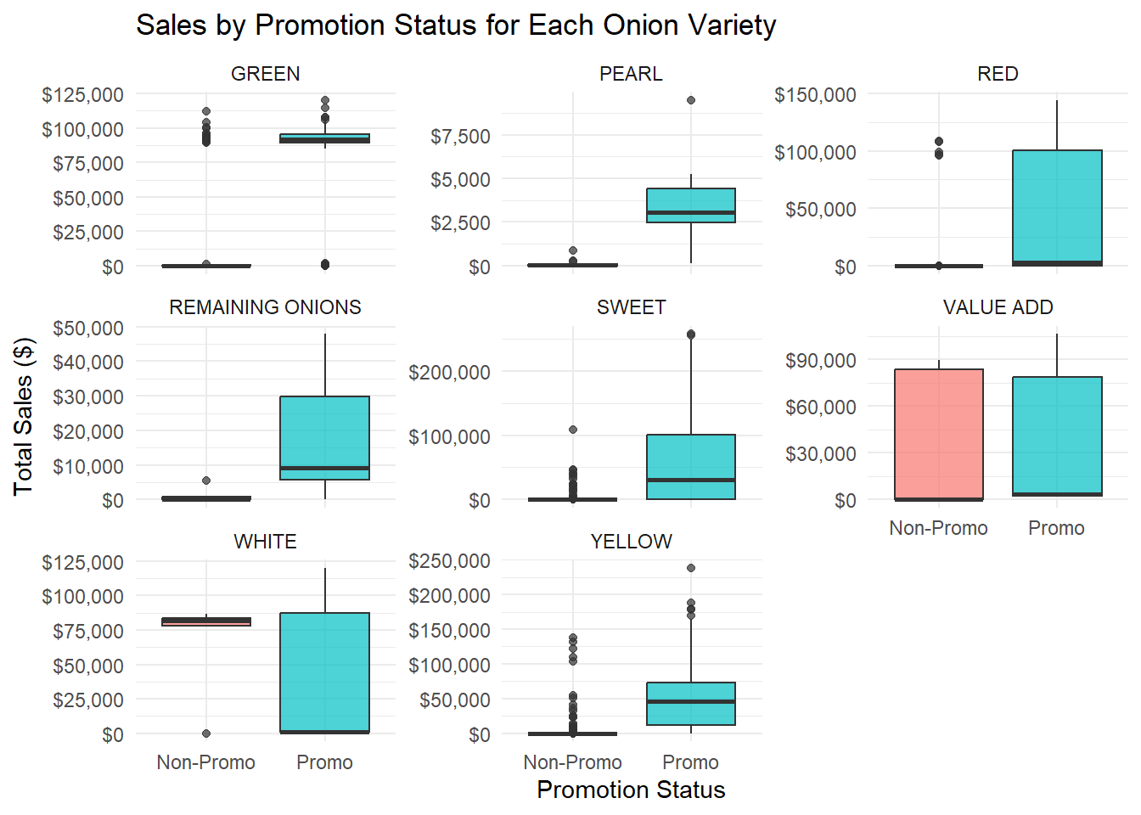
Regression Analysis of Promotions
This is the distribution of total sales with and without promotions
In most cases, except for White and Value Onions median total sales increases

Slide 13
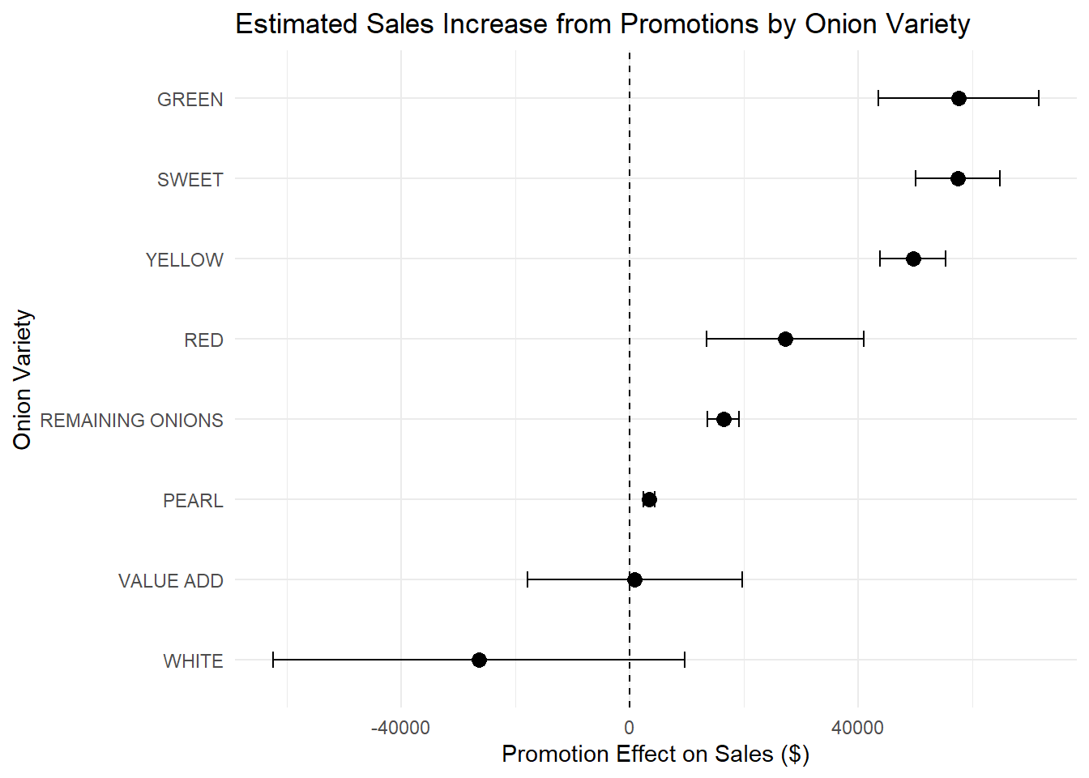
Regression Analysis of Promotions
These are the confidence int. from linear regression models for each variety
Each confidence int. Assumes there is a promotion
Each model was significant but this may be due to the size of the data set
Each R² was very low
Notes:
Mention Green onions making much more with promos

Slide 14
Action Items
Find pricing discrepancies with Shallot Onions
Investigate the low market shares for Mixed and Shallot Onions
Promote Green and Yellow Onions for increased total sales
Stop promoting White and Value Added Onions

